Slide 1

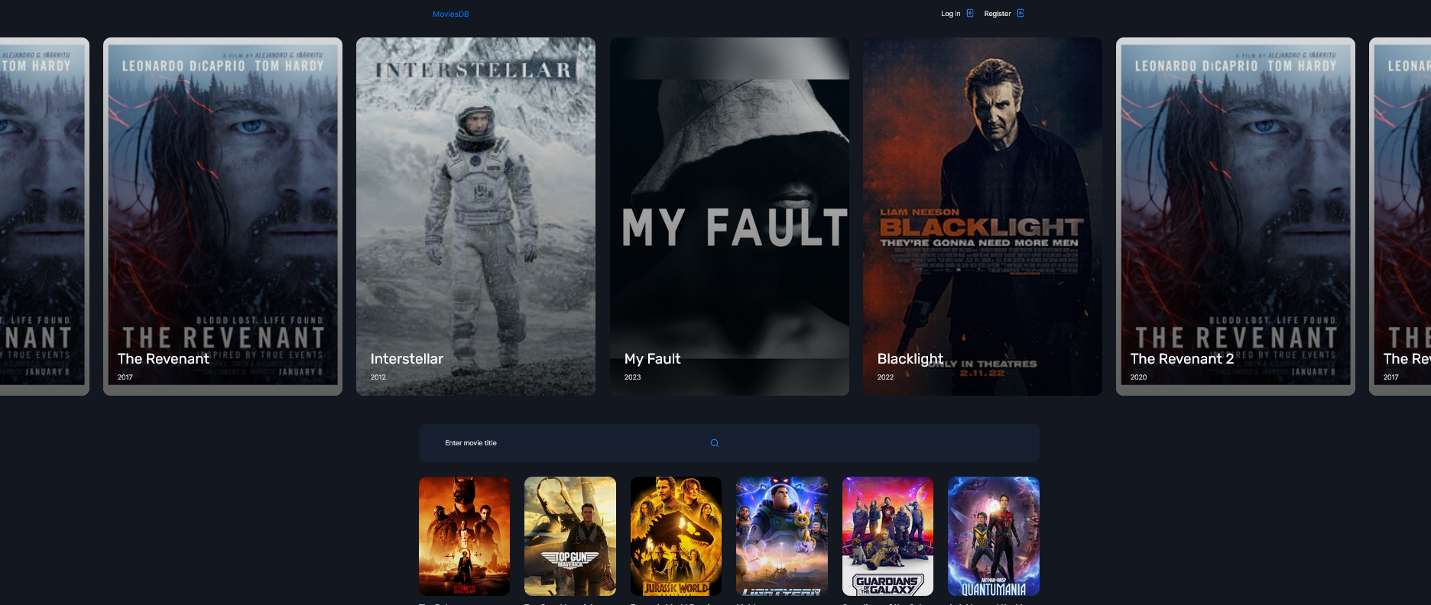
MoviesDB
Introduction
The MoviesDB ASP.NET Web App (MVC) project is a movie database application that allows users to display a list of movies, rate the movies, as well as search for movies by title.

Slide 2


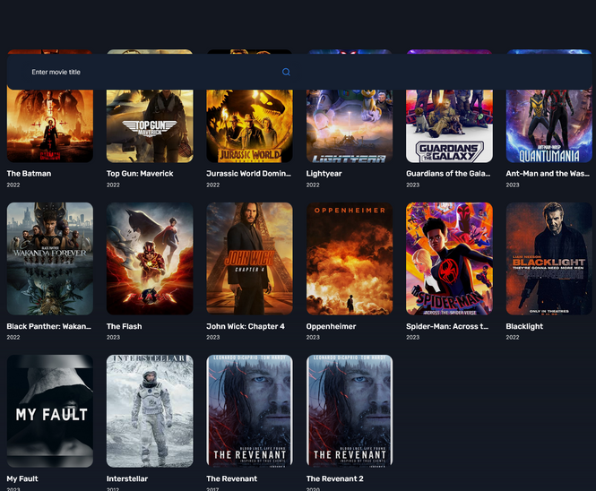
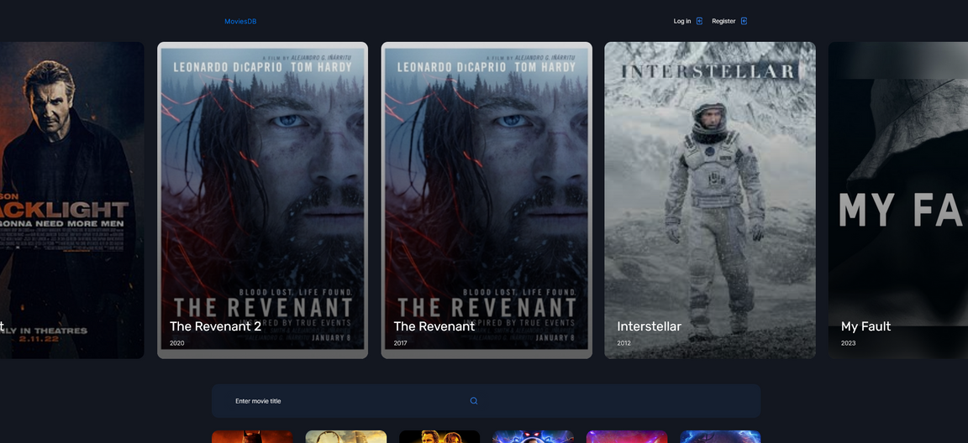
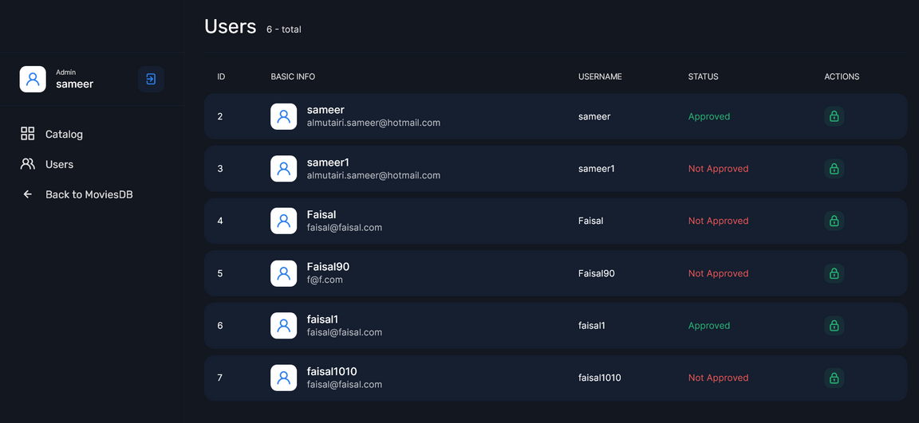
Project Overview
The MoviesDB application uses a SQL Server database and Entity Framework to manage movie data.
The application includes a homepage that displays a list of movies, a search page that allows users to search for movies by title and pages for rating the movies.
The user interface has been designed to be user-friendly and includes features such as responsive design, easy navigation, and intuitive forms.
The figures above describe the project overview

Slide 3
Movies Rating
Regular users can rate movies and view the average rating for each movie.
01
Functionality
User
Movie Details
The user can see the details of the movies including ratings, genres, director name.
02
User functionality, for the MoviesDB application
Movies Search
The users can search by movie name which will improve the user experience.
03

Slide 4
Users
Admin users can approve or reject user registrations
01
Functionality
Admin User
CRUD
Admin users can add, edit and delete movies
02
In addition to the basic user functionality, the MoviesDB application includes features that are only available to admin users.
Movies Ratings
Admin users can manage user ratings and view the average rating for each movie.
03

Slide 5
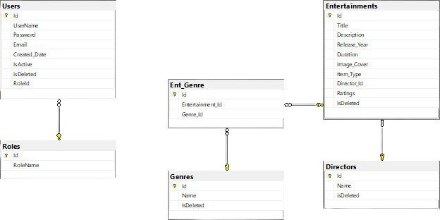
Database Schema
1
Users
2
Enterteiments
3
Directors
4
Roles

Slide 6

Our team
SAMEER ALMUTAIRI
SULAIMAN ALDUKHAIL
FAISAL ALKHALIFAH

Slide 7
The MoviesDB ASP.NET MVC project is a powerful and user-friendly movie database application that can be used to manage movie collections.
The application includes features for both regular users and admin users, making it suitable for a wide range of use cases.
The user interface has been designed with modern design principles and best practices in mind, ensuring that users can manage movie data quickly and easily.
Conclusion

